Slide 1
Digital Marketing

Slide 2
Introduction
Digital marketing is the marketing and advertising of a business, product, or service using online channels, electronic devices, and digital technologies.
Digital marketing is the use of the Internet, mobile devices, social media, search engines, and other channels to reach consumers.
Digital marketing is the use of the Internet to reach consumers.
Digital marketing is a broad field, including attracting customers via email, content marketing, search platforms, social media, and more.
A few examples of digital marketing include social media, email, pay-per-click (PPC), search engine optimization (SEO), and more.

Slide 3
Digital marketing targets a specific segment of the customer base and is interactive. Digital marketing is on the rise and includes search result ads, email ads, and promoted tweets – anything that incorporates marketing with customer feedback or a two-way interaction between the company and customer.
Internet marketing differs from digital marketing. Internet marketing is advertising that is solely on the Internet, whereas digital marketing can take place through mobile devices, on a subway platform, in a video game, or via a smartphone app.

Slide 4
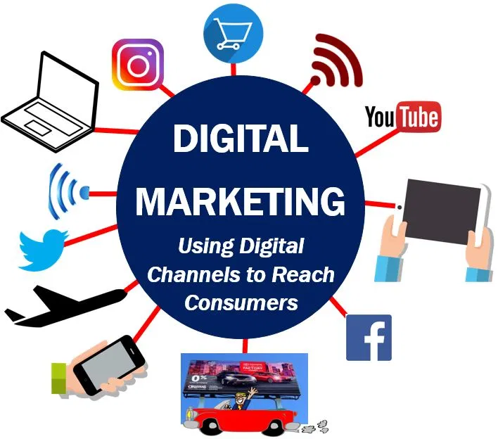
“At a high level, digital marketing refers to advertising delivered through digital channels such as search engines, websites, social media, email, and mobile apps.”

Slide 5
For companies today, digital marketing matters because it offers:
Multiple online marketing strategies
Cost-effective marketing solutions
Level playing field
Advanced targeting and personalization options
Accurate campaign tracking and measurement
Continuous campaign performance feedback

Slide 6
Digital marketing offers Multiple online marketing strategies
With online marketing, company can pick from a range of tactics.
SEO
PPC
Content Marketing
Conversion Rate Optimization (CRO)
Social media marketing & Advertising

Slide 7
Cost-effective marketing solutions
Price is another benefit of digital marketing.
Compared to traditional marketing, online marketing is extremely cost-effective.
If you advertise online, whether on social media, websites, or search engines, you set your budget and bid for ad space.
You have complete control over how much you spend, which isn’t the case when buying a billboard.

Slide 8
Level playing field
If you’re a small-to-midsized business (SMB), digital marketing also helps your company stand apart from larger brands.
That’s because online marketing offers cost-effective solutions, like SEO, that can help your business reach its audience.
This approach can help your company bypass big brands and reach your target market.

Slide 9
Advanced targeting and personalization options
Making web marketing a part of your business strategy also gives you access to a range of advFor example, with online marketing, you can use targeting options like:
Age
Location
Interests
Marital status
Hobbies
Device
And more

Slide 10
Accurate campaign tracking and measurement
Online marketing solves a traditional marketing problem — tracking.
With traditional marketing, it’s difficult to track whether someone found your business via a billboard, radio ad, or newspaper feature.
It’s easy to track the performance and results of digital marketing.
Tools like Google Analytics, Google Search Console, and Google Ads make monitoring your strategy easy. With Google Analytics, for example, you can track website traffic, user behavior, and website conversions

Slide 11
Continuous campaign performance feedback
Making digital marketing a part of your business strategy also gives you access to a marketing approach
That provides constant feedback on your campaign’s performance, whether it’s your SEO strategy or PPC ads.

Slide 12
Digital vs Real Marketing
Traditional Marketing (Real Marketing)
Traditional marketing is any form of marketing that reaches a user through offline mediums, without the use of the internet. Before the advent of the internet in the 1990s, only this type of marketing was used for decades. Some common traditional marketing methods include –
Tv commercials
Radio Commercials
Magazines
Newspapers
Billboards
Flyers and posters
Tele-marketing
Direct mailers, coupons

Slide 13
Digital Marketing
Digital Marketing is modern way of marketing Technique.
In which we promoting, selling products and services by online marketing.
It also refers to the Marketing of any kind of business through digital media and devices such as
Google,
Facebook,
Instagram,
youtube..etc.

Slide 14
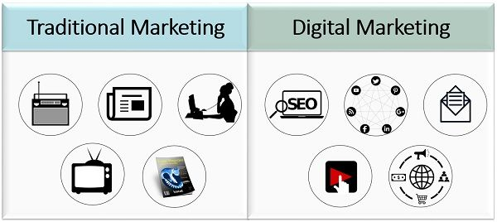
Example of TM & DM

Slide 15
ASIS FOR COMPARISON | TRADITIONAL MARKETING | DIGITAL MARKETING
Meaning | Traditional Marketing refers to the marketing that uses traditional channels or media, for the purpose of marketing communication. | Digital Marketing implies the marketing of products and services via digital channels, such as the internet, smartphone, display ads, and other digital medium.
Nature | Static | Dynamic
Conversion | Slow | Comparatively fast
Engagement | Low | Comparatively high
Return on Investment | Cannot be measured easily. | Can be measured easily.
Effectiveness and expensiveness | Less effective more expensive | Less expensive more effective
Tracking | Not possible | Possible
Targeting | Standardized | Customized
Tweaking | Not possible once the ad is placed. | Can be performed anytime, even after the ad is placed.
Reach | Local | Global
Results | Delayed results | Quick and real-time results
Interruptions | Consumers cannot skip the ads, as they are bound to see them. | Allows the consumers to avoid or skip the ads which do not interest them.
Communication | One-way Communication | Two-way Communication

Slide 16
Marketing Channels

Slide 17
1) Search Engine Optimization (SEO)
Search Engine Optimization, as the name suggests, is about making your website page rank higher on internet search engines like Google, Bing, etc. Suppose a user does an online search on ‘How to bake a cake.’ If the web page of your recipe is among the top results, the user is more likely to click on it.

Slide 18
2) Pay Per Click (PPC)
Pay Per Click can prove to be one of the most effective internet marketing channels if utilized correctly.
The goal of PPC is to turn latent users into engaged prospects and further convert them as buyers.
For example, clicking on an online display ad can lead prospective clients to another page whose content gives more information about it.

Slide 19
3) Email Marketing
Email offers a much more personal way of connecting with your targeted customers. It is a type of internet marketing that can truly make you stand out.
You can offer exclusive ‘insider’ content, special discounts, and customized content to your email subscribers to make them feel special.

Slide 20
4) Social Media Marketing
Social media is one of the most powerful internet marketing channels today. Platforms like Facebook, Instagram, YouTube, Twitter, etc.
provide a space for dynamic two-way communication. Internet users spend most of their time in these online spaces. So, brands cannot miss the opportunity to grab more eyeballs and effectively need to promote their brands.

Slide 21
5) Video Advertising
Video advertising is one of the most entertaining and interactive online marketing channels.
It includes online display ads that have a video within them. Such ads are also played before, during, or after a video stream.

Slide 22
6) Network Marketing
Network marketing is an offshoot of the social media marketing that makes use of the associations and groups existing all over the internet.
It is all about identifying a pool of influencers, wholesalers, or professionals who can tell your targeted audience about your business.

Slide 23
7) Contextual Marketing
Contextual marketing is not just a form of advertising but also a brand image-building exercise.
Here, the marketer intends to advance the business without being a stickler about the medium used.

Slide 24
8) Affiliate Marketing
Online sellers can get other dealers to sell their products and services. This is called affiliate marketing, wherein one business offers another’s products as an add-on or deal package along with its own.

Slide 25
Create a Digital Marketing Plan

Slide 26
What you need is a digital marketing plan
A digital marketing plan helps you organize your initiatives so that you’re continually connecting with your audience, engaging them, and driving them to action.
With a digital marketing business plan, you think ahead, coordinate among departments, and integrate your digital marketing for greater impact.

Slide 27
In the document where we outline our marketing plan, these items can’t be forgotten. They help us articulate our campaigns and plan them:
Short, medium, and long term business goals.
The strategies to achieve the goals at the digital level.
The channels to use.
Action and development plans.
Investment and budget.
The timing and roadmap.

Slide 28
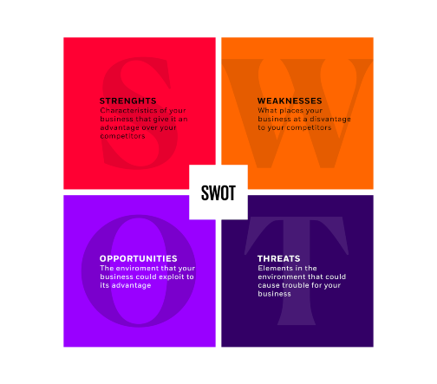
Structure of Digital Marketing Plan

Slide 29
Step 1: Situational analysis
The first thing you need to do when developing your digital marketing plan is to carry out an internal and external analysis (SWOT analysis) of the company.
A useful framework for this is the SWOT analysis that allows you to look at the strengths, weaknesses, opportunities, and threats for your company and the market at large.
Implementing bench marking techniques is a very common practice in companies to identify the best practices and success stories and extract an example for your digital marketing plan.

Slide 30
Step 2: Establish Digital Marketing Goals
Once you have your place in the market and your strong points in mind, work on establishing some goals to create a clear idea of where your actions should take you. Everything you plan has to work towards meeting those goals.
You can work on developing this part of your digital marketing plan with the SMART goals framework in mind: specific, measurable, attainable, relevant, and timely goals.

Slide 31
Step 3: Define the Marketing Strategy
Personalization is becoming increasingly important in digital marketing. Therefore, when it comes to defining your strategy for carrying out your plan, keep these factors in mind:
Segmenting your target audience:
Positioning
Content strategy
content strategies, some tools used to execute this strategy are:
Keyword research
Social posting

Slide 32
Step 4: Digital Strategies and Tactics
Based on our objectives (attraction, conversion, and loyalty), we’ll start to carry out different strategies: email marketing campaigns, social media, CRM, web optimization, SEO strategies, paid media advertising, etc.
Today, considering that the number of channels to manage is multiplying and the amount of information we get about our customers is increasing, it’s critical we use Marketing Automation tools that let us automate our marketing campaigns.

Slide 33
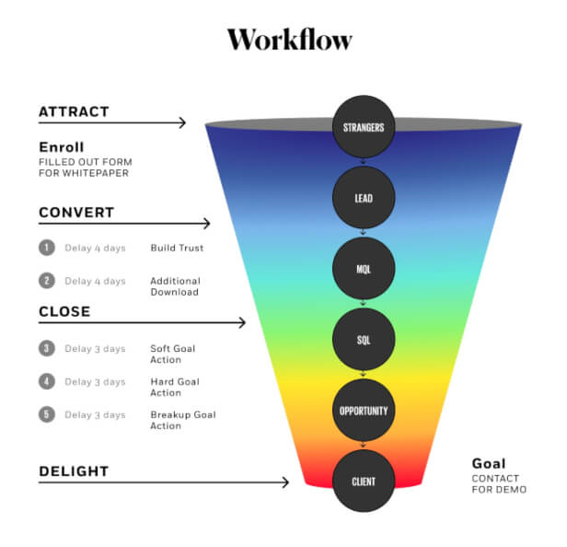

Slide 34
Step 5: Measuring Results & KPIs
The next step is one of the most important: analyzing the results. Analytics has turned into a critical pillar for successfully optimizing digital marketing performance and spending.
We have to measure every action using KPIs to figure out if we earned the expected ROI.

Slide 35
Content Management

Slide 36
Content management (CM) is a set of processes and technologies that supports the collection, managing, and publishing of information in any form or medium. When stored and accessed via computers, this information may be more specifically referred to as digital content
Digital content may take the form of text (such as electronic documents), images, multimedia files (such as audio or video files), or any other file type that follows a content lifecycle requiring management.
A CMS is an application that is used to manage and publish web content, allowing multiple users to contribute, create, edit, publish without having to beg a developer.

Slide 37
Content Management Process
Content management practices and goals vary by mission and by organizational governance structure. News organizations, e-commerce websites, and educational institutions all use content management, but in different ways. This leads to differences in terminology and in the names and number of steps in the process.
For example, some digital content is created by one or more authors
Publishing may take many forms: it may be the act of "pushing" content out to others, or simply granting digital access rights to certain content to one or more individuals. Later that content may be superseded by another version of the content and thus retired or removed from use (as when this wiki page is modified).

Slide 38
Content management is an inherently collaborative process. It often consists of the following basic roles and responsibilities:
Creator
Editor
Publisher
Administrator
Consumer, viewer or guest

Slide 39
Content Management Types
1. CMA
2. CDA
content management application
allows marketers, merchandisers and other content creators to work with content directly, without needing to involve the IT department.
content delivery application
acts as the back-end portion of the website, taking the content that you enter into the templates and turning it into a working website that visitors from around the world can access.

Slide 40
Features in a CM
1. Security
Making sure your business is secure from cyber attacks is incredibly important. Not only do attacks interrupt the continuity of your business, but they also cost you huge amounts.
2. Omnichannel and Multilingual Support
A Web Content Management system that supports easy multi-language, multi-channel delivery not only makes this job much easier, but it also empowers local brand and content managers to run localized campaigns on the channels best suited for their markets while maintaining the global brand identity.

Slide 41
User-friendliness
Empowering your employees to support your globalization efforts starts with simplifying the process they use to do so.
Using a content management system that is intuitive for the end-user, and that allows employees to quickly re-use branded components such as images, designs, and experiences, will encourage teams to take ownership of the local experience - especially if it also allows all users to use the system in their preferred language.
Testing & Experimentation
To further support your global teams in their localization of the brand into new markets, it’s crucial that they can quickly evaluate the results of their efforts and take autonomous action based on this feedback.

Slide 42
Personalization
A CM system that allows you to automatically personalize digital experience elements like campaigns, content, or product grids will provide more agility to global teams, as they can easily create variants of the site experience from one global system.
It will also allow businesses more control over the global brand, supporting globalization at scale.
Analytics
Use a content management system that has a built-in analytics engine, so your marketing teams, content creators, and brand managers can easily spot visitor trends and opportunities for improvement in the digital experience based on local visitor data.

Slide 43
Scalibility
Businesses that run their WCM in the cloud will be able to scale their globalization efforts much faster, with development teams able to roll out updates to the digital experience worldwide with just a few clicks, while taking advantage of the uptime and continuous improvements offered by cloud providers.

Slide 44
Content management systems and tools
content management platforms for specific content types, there are also general content management systems (CMS) which provide automated processes for collaborative digital content management and creation.
A CMS commonly includes features such as format management, publishing functionality and the ability to update content
A digital asset management (DAM) system is another type of CMS that manages documents, movies and other rich media assets. A few examples of notable CMSes are WordPress, Joomla, and Drupal.

Slide 46
SWOT Analysis

Slide 47
SWOT Analysis
A SWOT analysis is a framework used in strategic planning and marketing. It provides you with the knowledge to create plans to improve your business
SWOT analysis stands for Strengths, Weaknesses, Opportunities, and Threats. It is the strategic planning of your company, product, business, or industry
There are two categories in SWOT analysis
Internal
External

Slide 48
Internal Factor
Internal factors are the strengths and weaknesses of your business, product or service. It could be the quality of your product, its unique selling proposition, the strength of your team, your marketing strategy and so on.
The internal factors are something that we have direct control over. These are things that can be improved or changed as it applies internally to us.

Slide 49
External Factors
Opportunities and threats come under the external category of the SWOT analysis.
These are things that you may not have direct control over however by understanding the opportunities and threats in your market, you could indirectly affect your business by making the necessary changes in your approach.

Slide 50
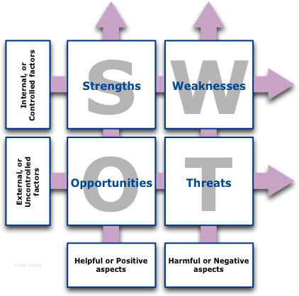

SWOT Analysis

Slide 51
Insightful Digital Marketing steps
> Determine Strength
> Determine Weakness
> Find Opportunities
> Find Threat
> Develop a Strategy

Slide 52
Determine Strength
Strengths are internal and helpful. Strengths are factors that support an Opportunity or overcome a Threat to give you advantage. Strengths may include …
Financial strengths. A robust balance sheet, good cash flow and good credit rating.
Technological and production advantages (Plant, machines and associated techniques).
Customer service advantages in marketing, sales and reputation.
Talented, dedicated and well trained employees

Slide 53
Determine Weakness
Weaknesses are internal and harmful. Weaknesses are factors of your business that mean you are unable to take advantage of an opportunity, or are vulnerable to a Threat. Weaknesses may include …
Financial weaknesses such as high debt ratios.
Old or inflexible technology.
Customer service weaknesses, for example, long delivery times or poor customer communications.
Skills shortages or poor employee morale.

Slide 54
Find Opportunities
Opportunities are external factors over which you have no control and are helpful.
Opportunities arise from many sources:
for example, competitors withdrawing from the market, new social trends, and technological innovations.

Slide 55
Find Threat
Threats are external factors over which you have no control and are harmful.
for example, a new competitor, restrictive regulation, hostile takeovers.
What are the barriers?
Does a Government regulation can hurt your business?
Does a technology change can make your product obsolete?
Are competitors working on a better product/service?
Do you have Cash-flow or bad debt issues?

Slide 56
Develop Strategy
SWOT is a data and information gathering framework which records input factors. In a typical analysis project, each of the four boxes would contain a list of factors — typically as a bullet-point list
Although these four lists are interesting as a classification of input factors, they don’t yet help us to develop a strategy. To make SWOT useful, two additional features are needed …
Turn SWOT inside out to become TOWS and reveal generic approaches for development into specific strategic actions
Consider what to do with the factors. This is done by the application of two verbs: Match and Convert.

Slide 57
Match
Matching is the process of linking the external factors — Opportunities and Threats — to the internal Strengths and Weaknesses
Convert
The principle of Converting is to encourage you to think about actions that change harmful factors into helpful factors. Figure 10 below shows the possible conversions within SWOT:
Threat factors may be turned into a strategic advantage by converting the Threat into an Opportunity.
Weakness factors may be converted into Strengths.

Slide 58
These four generic strategies are …
Growth strategies (Opportunity × Strengths)
The essence of a growth-based strategy is to Match the Opportunity to your existing Strengths and do more of what you’re already good at. A growth-based strategy usually involves investing in those factors that increase your capacity to do more of the same thing.
Internal development strategies (Opportunity × Weaknesses)
The main consideration in this type of strategy is to Convert weaknesses to strengths so they can be matched to an opportunity. An internal development strategy is about repairing or developing internal factors

Slide 59
External development strategies (Threats × Strengths)
This type of strategy is based on using your existing strengths to convert a threat into an opportunity. An external development strategy may include extending your marketing reach into new areas or new customers through advertising;
Survival strategies (Threats × Weaknesses)
A threat and weaknesses combined — the worst possible scenario. Here you are faced with stark choices; for example, fundamentally change what your organisation is or does, or ultimately dissolve the business and release the capital back to the shareholders

Slide 60
TARGET GROUP ANALYSIS
TGA
A target group analysis is an effective method to define a target group. It is considered an important tool in market research and is particularly relevant in product development.
A target group analysis pursues thereby as a clear goal, the potential customers and/or the own target group, to become better acquainted.
This helps you again to regard their needs and interests more detailed. So you succeed even better to address the goals and desires of the target group.

Slide 61
Why is a target audience analysis so important?
TGA
Your marketing measures can only be successful and targeted if you know your target group.
Only then can you respond to their needs. Customized and perfectly targeted campaigns and content are the first step in this direction. This is how you generate trust and added value, which has an impact on user experience and customer satisfaction. This, in turn, pays lasting dividends to the success of your business.
A target group analysis pursues two clearly defined goals:
Retain existing customers
Acquire new customers

Slide 62
TGA
Retain existing customers
Acquire new customers
In order to retain existing customers, you can carry out various measures:
Analyze existing customers
Identify commonalities
Target marketing measures for customer loyalty more effectively
Respond to customer needs in a timely manner with your own product or service portfolio
There are also various ways to acquire new customers:
Analyzing your own products or services with the intention of solving problems and awakening customer needs
Identification of new target groups
Alignment of marketing measures

Slide 63
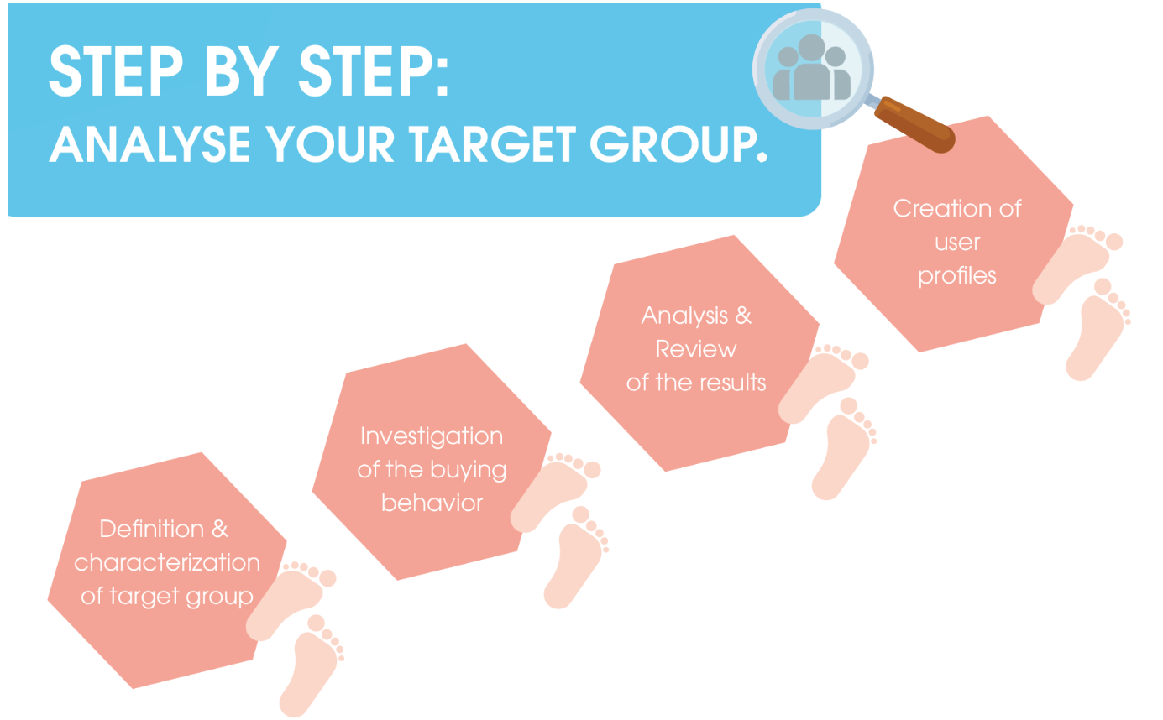
TGA

Slide 64
Step 1: Define and characterize the target audience
TGA
Finding the right target audience is essential to your success. Therefore, the first important step of a target group analysis is to collect information to define your target group exactly. Only if you know how they act and think, you can tailor your campaigns to fit them exactly.
DEMOGRAPHIC FEATURES | SOZIOECONOMIC FEATURES | PSYCHOGRAPHIC FEATURES | BEHAVIOR
Age | Education level | Motivation | Price sensitivity
Gender | Occupation | Oppinions | Customer satisfaction
Family status | Income | Desires | Purchase range

Slide 65
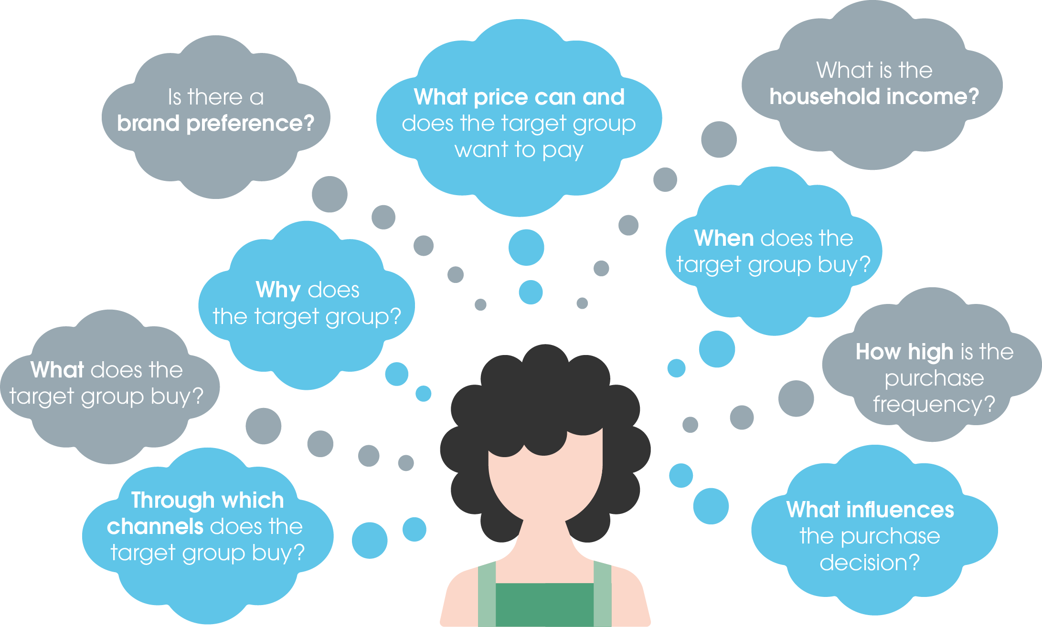
Step 2: Investigate buying behavior
To find out how your target group responds to products or services, it is important to know the buying behavior.
For this purpose, there are very individual characteristics by which the consumption habits differ within a target group. The following guiding questions will help you to gain insights into the buying behavior of potential customers. This will give you a better impression.
To answer these questions, you can, for example, draw on statistics, public surveys, or your own empirical values and collected data. Also, Google Trends is a good way to generate insights and assess a trend development

Slide 66
Step 3: Analyze and review the results
So far, you have already diligently collected data and are as good as done with your target group analysis. Before you use those data and results for marketing purposes, you should check them again. In this phase, for example, it is a good idea to start a market research. It does not have to be complex. It is simply a matter of determining whether your results are correct and work in practice before you implement specific marketing measures.

Slide 67
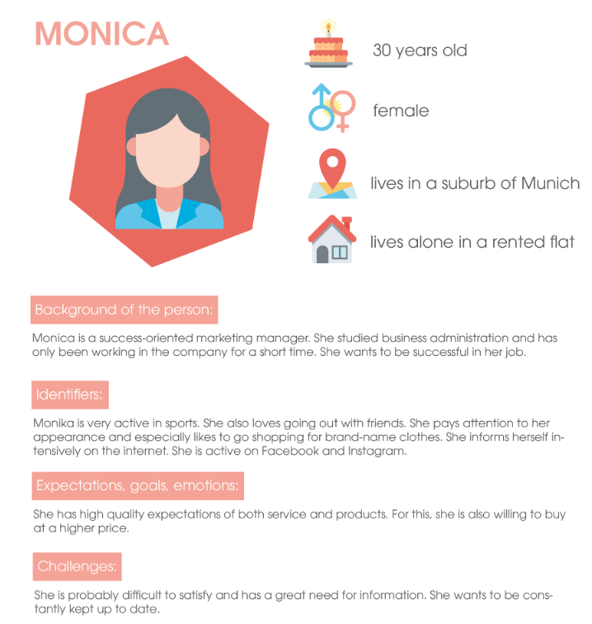
Step 4: Create user profiles or persona
Now you are almost at the end of your target group analysis. Through surveys, interviews, your own experiences, etc., you have already defined your target group pretty well. However, the final goal of your analysis should be to create a user profile that helps you better understand the desires, goals and needs of your target group. In addition, these personas make it easier for you to put yourself in the user’s shoes.
User profiles thus portray specific target group representatives. Their detailed and meaningful description turns a fictitious and rather abstract target group into a person with name, age, gender, etc. This makes them more tangible.

Slide 68
Web design

Slide 69
Your website is the representation of your products or services that you offer. It’s the place where most people will interact with you for business.
It only makes sense if you come forward, interact with your audience, and satisfy their thirs
website is often the first point of contact potential customers have of your company and your brand. It only makes sense then that you put your best foot forward and effectively communicate what you’re all about through professional and user-friendly web design.t with their needs.

Slide 70
Web design encompasses a multitude of variables including layout, content, graphics, search engine optimization and conversion rate optimization.
While web design is a significant and critical component of your promotional efforts, many businesses forget that it’s just one part of an overall digital marketing plan and should be consistent in look, feel and purpose with your other marketing efforts such as pay per click advertising.

Slide 71
Importance of Web Design in Digital Marketing
According to the tech terms computer dictionary definition, web design is essentially the process of creating websites. It encompasses several different aspects, including webpage layout, color choice, fonts, graphics, and content production.
While the terms web design and web development are often used interchangeably, web design is technically a subset of the broader category of web development.
A business website is the common and primary point of contact for customers. It showcases your business’ professionalism and demonstrates your expertise and market reputation. It is precisely because of this that website design is so crucial for any digital marketing plan.

Slide 72
Your website is the place where most people will interact with your business. Both your online and offline marketing activities will most likely send users to your website. Whether it’s to get information about your services and products, to make bookings or purchases, or to get contact details.
your website with the following factors in mind:
Conversion rate – are you converting leads/customers?
Competition – are you outperforming competitors or vice versa?
Branding – does your website reflect your brand?
SEO – are you performing well on search engines?
Responsiveness – is your site responsive?
Site speed – do your pages load quickly?

Slide 73
The goals of web design
To understand how to create well designed websites, it is worth understanding the fundamentals of design. Good design creates experiences that makes people’s lives easier, and is also aesthetically pleasing.
Here are some examples: a well-designed store makes it easy for customers to fi nd products they are looking for, or maybe even products they never knew they wanted.
When designing for the web, there are some unique challenges compared to other disciplines arising from the fact that web design is still in its infancy and is evolving rapidly. Even the defi nition of web design is evolving and diffi cult to defi ne. Originally, web design meant designing pages for a web browser. While this is still true, you now need to consider the rapidly evolving nature of mobile devices, tablets, smart phones, and consumer electronics that access the web

Slide 74
The web demands user interaction
The experience of a website is defi ned by the interaction the user has with it. For example, a user clicks on navigation or scrolls down to read a page.
Even the act of reading a book can be defi ned as user interaction. In the Western world, people read from left to right down a page, they turn pages, and scan page numbers and tables of contents in order to fi nd a certain chapter or topic.

Slide 75
Defi ning the user experience
When it comes to user interaction, off ering too many options can be just as bad as not off ering enough.
If there are multiple pathways available to the user, it is the designer’s responsibility to make sure the user doesn’t get lost.
The entire sum of a user’s interactions with a website can be called the user experience.
The focus on the user experience diff erentiates websites from printed products more than anything else. This job is so important that there are web professionals called information architects.

Slide 76
User-centered design
It can be diffi cult to describe how a web designer works because the level of involvement in a project can vary, from developing a project on her own, to being part of a large team in an advertising agency

Slide 77
The stages of the planning process
The stages of the planning process can generally be defined as:
• Defining goals and strategy
• Research
• Information architecture
• Sketching
• Wireframes
• Mockups

Slide 78
Defi ning goals and strategy
When designing a website, an important question to ask is, “Why does this website need to exist?” It seems strange but a client might not be able to tell you exactly why they want a website. The answer, “Because everyone else has one,” is not a good answer.

Slide 79
Research
A designer who is practicing user-centered design needs to have some background on what visitors to a site might be expecting. Competitive research is one way to fi nd this information. In the SmoothieWorld example, there may not be many competing smoothie sites; however, there are certainly a number of popular recipe and cooking sites. You should understand how these sites are designed and what makes them so attractive to users.

Slide 80
Information architecture
Design is not just about visuals. The word design comes from the Latin word designare, which means to mark out, devise, or choose. This is a good reminder that you should choose or plan the structure of a website before you consider the visuals. The term used to describe the planning

Slide 81
Wireframes
Wireframes are typically created in black and white or shades of gray, using placeholders for images. Wireframes avoid the visual design of the site and are more concerned with the organization of the content and features.
Mockups
Mockups are sometimes the result of wireframes, although it is possible to skip the wireframing step for less-complex sites. You can create them in an image editor such as Photoshop

Slide 82
Optimization of Website

Slide 83
Website optimization is the process of using tools, advanced strategies, and experiments to improve the performance of your website, further drive more traffic, increase conversions, and grow revenue.
Optimizing your website for real people helps you gain your visitors’ trust, starts building a relationship, and lets you sell products without having to jump on a sales call.
website optimization approach combines a variety of disciplines to make sure your website performs ideally in all areas:
SEO
Copyright
Analytics
UX Design (Frontend)
Web Development (Backend)
CRO/Landing Page Optimization.

Slide 84
SEO
SEO means Search Engine Optimization and is the process used to optimize a website's technical configuration, content relevance and link popularity so its pages can become easily findable, more relevant and popular towards user search queries, and as a consequence, search engines rank them better.
Search engines recommend SEO efforts that benefit both the user search experience and page’s ranking, by featuring content that fulfills user search needs. This includes the use of relevant keywords in titles, meta descriptions, and headlines (H1), featuring descriptive URLs with keywords rather than strings of numbers, and schema markup to specify the page's content meaning, among other SEO best practices.

Slide 85
Copyright
Copyright is a legal term describing ownership of control of the rights to the use and distribution of certain works of creative expression, including books, video, motion pictures, musical compositions and computer programs.

Slide 86
Analytics
Digital marketing analytics enables marketers to evaluate the performance of their marketing initiatives and informs future decision-making by providing deep insights into consumer behavior.
The most robust marketing analytics tools gather data from the multitude of channels today’s enterprises use to connect with and engage customers.

Slide 87
UX Design
UX designers stand for 3 aspects in the process of improving the user experience:
· Usability
· Accessibility
· Pleasure
The meaning of UX in digital marketing is how the user is experiencing and feels when he interacts with digital marketing when it comes to the customer to contact with the brand for conversion between landing pages, contacts, and mobile apps.
Those are the examples of the UX in Digital Marketing:
· Brand voice and tone
· Load speed

Slide 88
Web Development
website is the representation of your products or services that you offer. It’s the place where most people will interact with you for business. It only makes sense if you come forward, interact with your audience, and satisfy their thirst with their needs.
Even if you do offline marketing or activity, it will most likely send users to your website. Whether it’s about purchasing the product or leveraging services or to make bookings, or to get contact details.

Slide 89
CRO
CRO stands for Conversion Rate Optimization. CRO marketing is a method of increasing the percentage of your website's visitors who take a desired action (or, to use marketing speak, who 'convert'). Conversions are a marketer's holy grail, but the term can mean different things depending on your company's goals.

Slide 90
How to optimize your website
Keyword research:
On-page-SEO:
UX: Improve page speed and experience
Backlinks
Learn advanced techniques and tackle more ranking factors

Slide 91
Keyword research:
The foundation of any SEO tactic, strategy, or process is keyword research. You need to understand which keywords and terms your target customers are actively googling.
This knowledge will help you with everything from planning and writing content for your website, to creating landing pages, campaigns, and tracking your results.
There are a lot of different tools for keyword research out there, but the most basic option is available for free: Google Ads Keyword Planner.
If you have a Google Ads account, you can use it to search for new keywords to target with ad campaigns, but it’s also useful as a starter research tool for SEO.

Slide 92
On-page-SEO:
It’s not just the pages you decide to create that impact your SEO. How the content is written, the content’s structure, your site’s structure, navigation, external links, and many other little details matter.
These SEO optimizations you can make by just editing your website is referred to as on-page SEO. And it can make a massive difference.
In a case study, only optimizing on-page SEO improved the top 5 keywords average position from 18.4 to 2.6 in only three days.
As mentioned above, you can use Google Search Console to search for issues and indexation errors. But you can also analyze other on-page factors.
The key is to make sure that important SEO pages receive a priority when it comes to internal links.

Slide 93
UX: Improve page speed and experience
Dwell time is an important SEO ranking factor. It measures how much time, on average, a user spends on your page before returning to Google.
If a user clicks your page in the search results, visits your site, and it takes too long to load, chances are they will just return to Google and choose something else.
So the visitor left without meaningful interaction with your site and brand. And if it happens too much, Google will assume that your page isn’t as relevant as they thought, and reduce your rank over time.
The more this happens, the lower your Google position is likely to be.

Slide 94
Backlinks
A backlink, or a link from another domain to your website, is one of the most important signals to Google that your content is authoritative.
The idea is simple. Since other people are willing to share and co-sign your content, it must be good.
It used to be the most important ranking factor, bar none, and the number of referring domains still has the most visible connection with SERP ranking and organic traffic volume.

Slide 95
Learn advanced techniques and tackle more ranking factors
Once you’ve learned the basics of SEO, it’s time for you to jump in and learn more about different ranking factors and advanced strategies.
There are over 200 known Google ranking factors out there, so obviously getting familiar with each one and using it to your advantage is going to take time.
To keep learning about the subject of SEO, you must rely on high-quality resources that focus on data-based content and cutting-edge strategies.
The following is a non-exhaustive list of websites you can rely on to expand your SEO knowledge:
Backlinko
Ahrefs Blog
SEMRush Blog

